Slide 1
Python ETL Layer -- Using AWS Cloud Infrastructure
Shanker Valipireddy

Slide 2
Executive Summary
Objective and Scope
The proposed work plan aims to create the Python ETL script (etl.py)and create a MySQL RDS instance using CloudFormation template. Once created, integrate the ETL script with MySQL and store the transformed table into MySQL transformed_table
The project will be divided into several stages, Create Python ETL script, Create CloudFormation template, Create CloudFormation stack which provisions the MySQL RDS Instance and test the ETL script and it’s integration with MySQL database
A detailed steps at each stage is provided. Architecture diagram provided
Key Deliverables :
The key deliverables of the project include Python ETL script uses PySpark, CloudFormation template, MySQL JDBC connector
Potential Outcomes:
The potential outcomes of the project include the successful ETL layer

Slide 3
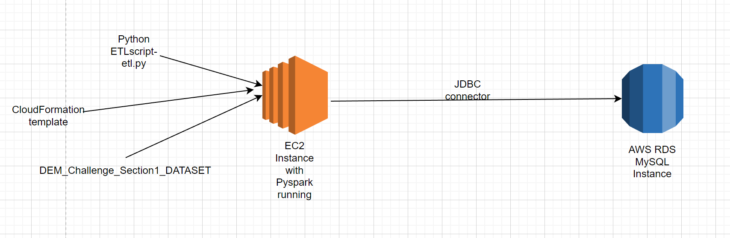
Project Architecture
ETL layer
Initially launched EC2 instance and stored the etl.py script and the input data given in the challenge.
Provisioned the AWS RDS MySQL instance with the help of CloudFormation template.
Integrated the Python script with MySQL

Slide 4
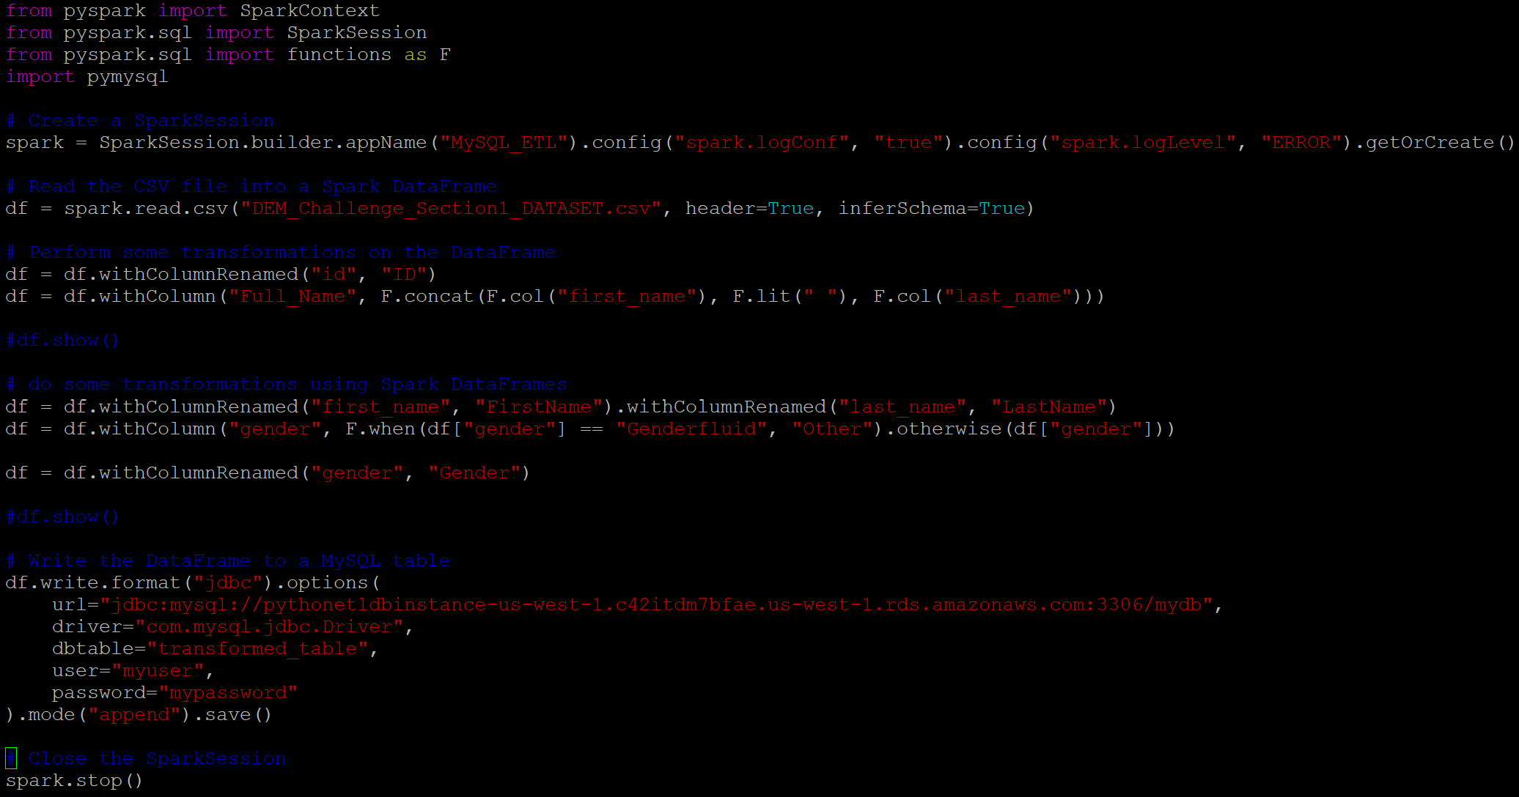
Work Plan- Steps
Below are the steps performed to ETL Layer
Created Python script(etl.py) which uses the pyspark and pymysql libraries:

Slide 5
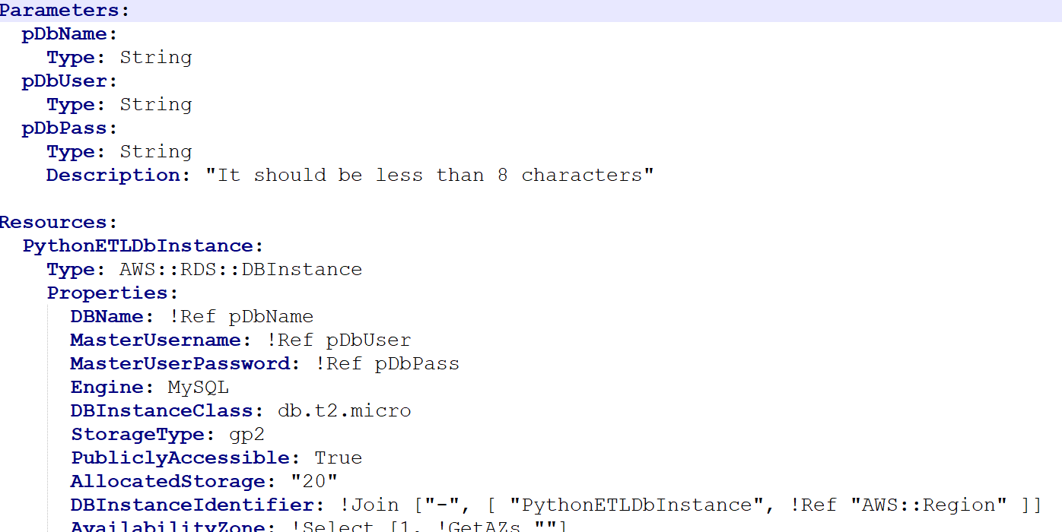
Work Plan- Steps
Below are the steps performed to create the ETL Layer.
2. Created a CloudFormation template to provision MySQL database with credentials(username,password):

Slide 6
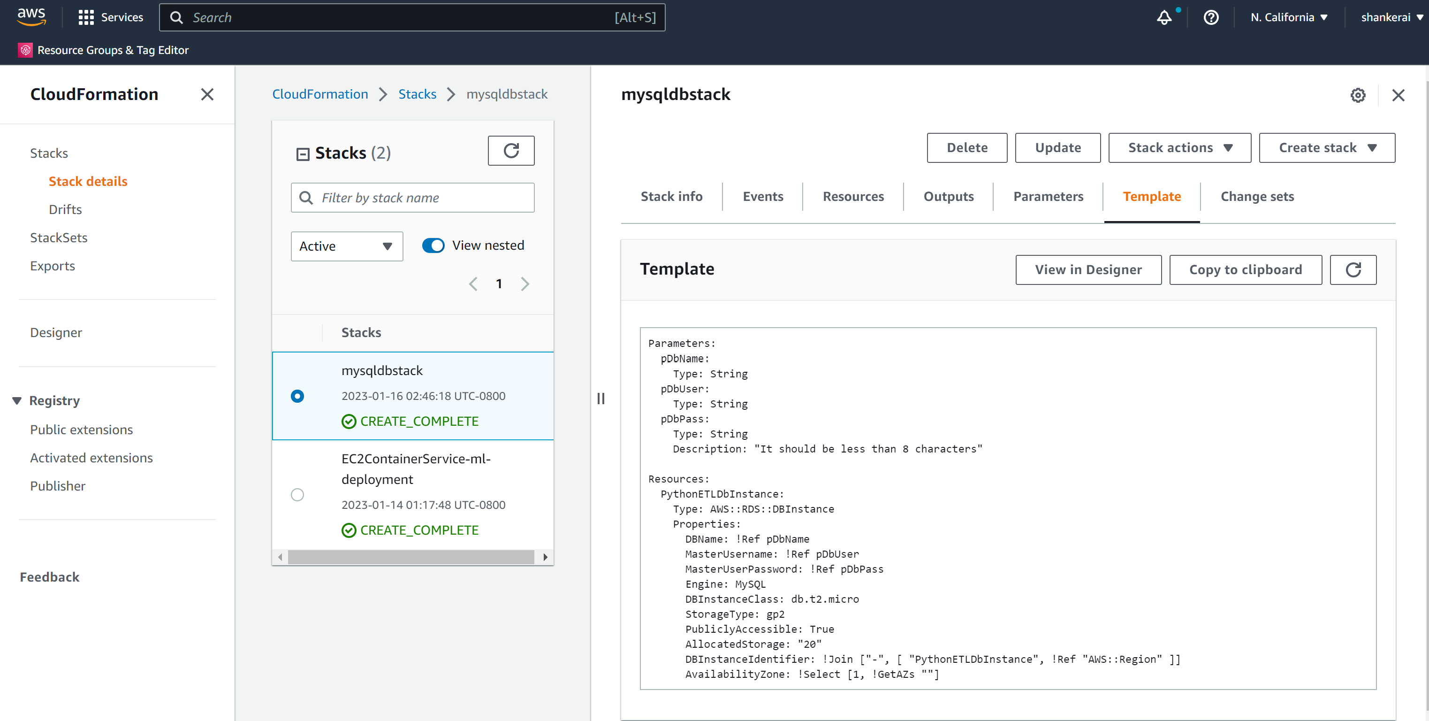
Work Plan- Steps
3. Created CloudFormation stack using AWS console.

Slide 7
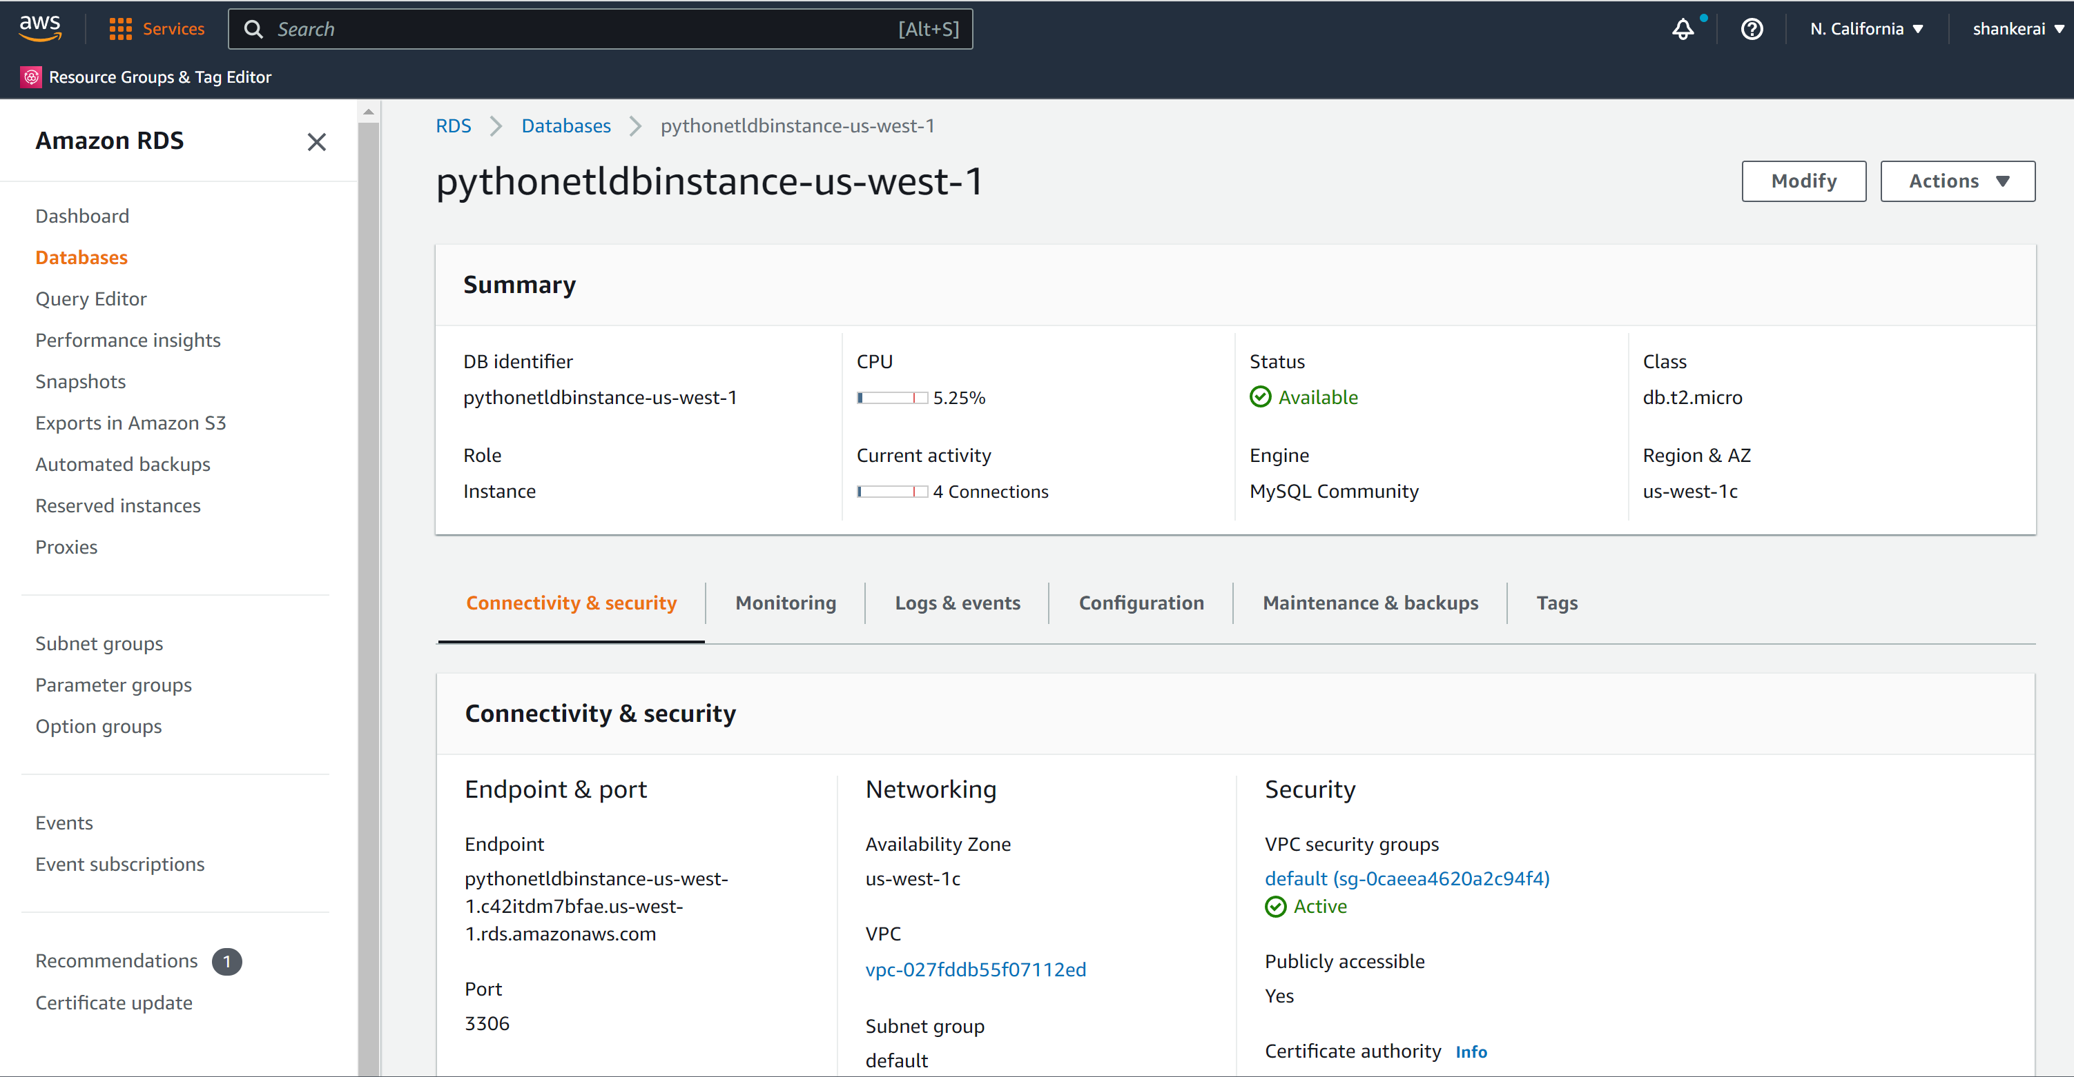
Work Plan- Steps
4. Create AWS RDS MySQL database instance.
.

Slide 8
Thanks

